Slide 1
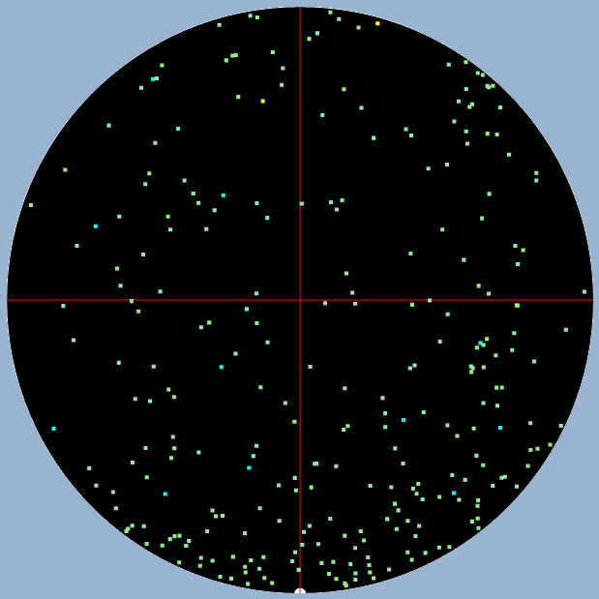
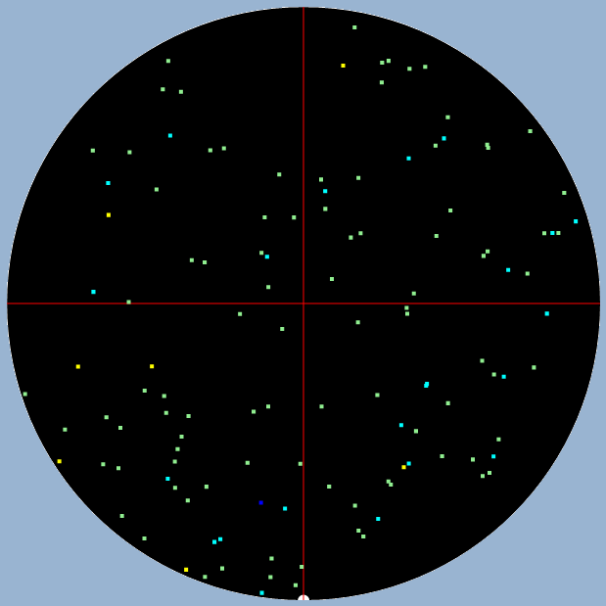
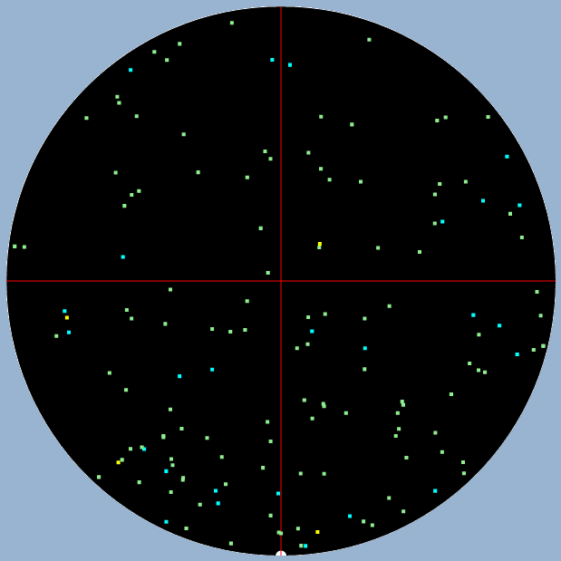
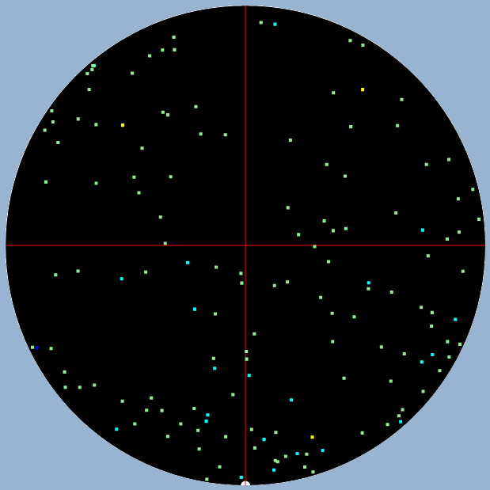
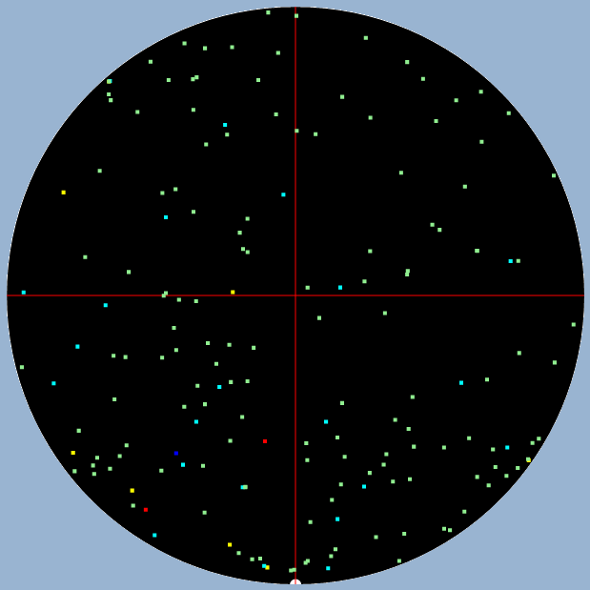
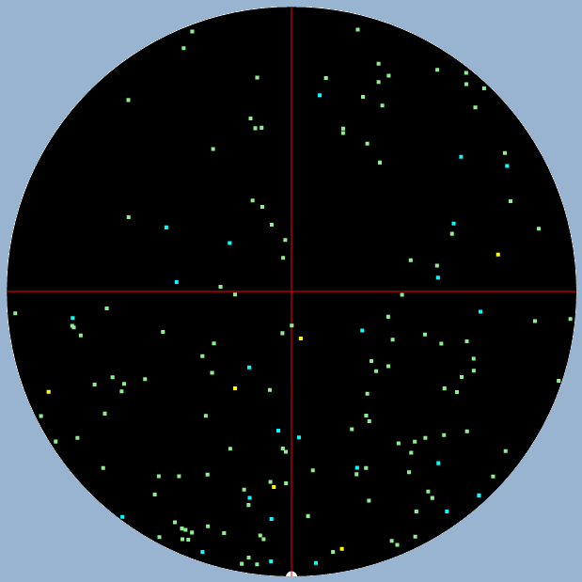
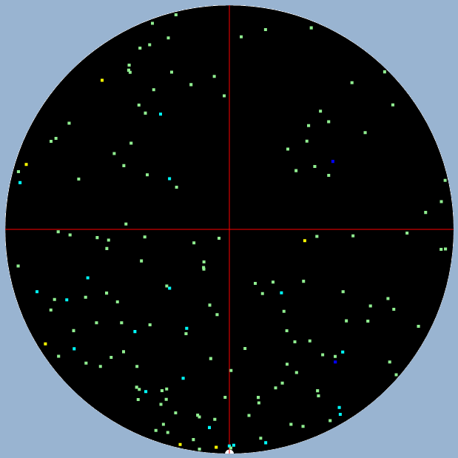
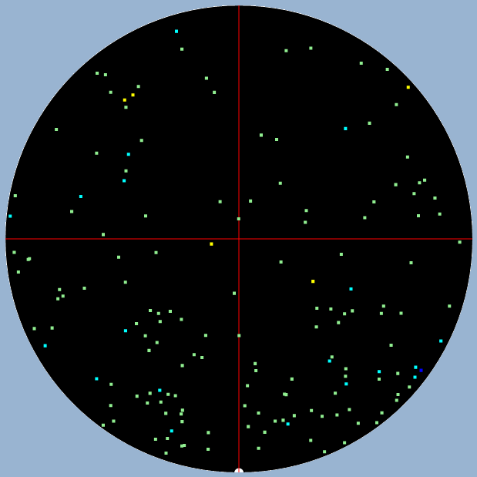
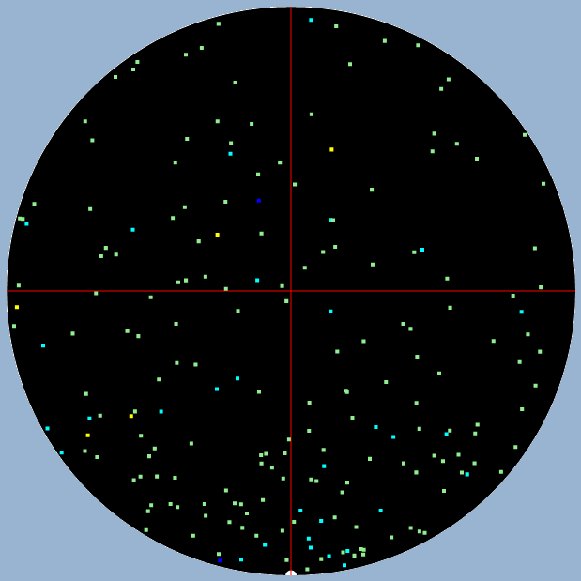
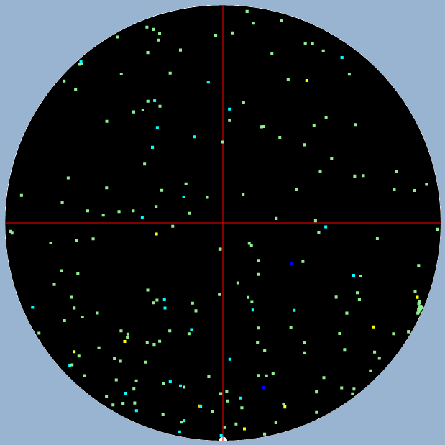
No.25 | No.24 | No.23 | No.22 | No.21
NKAAEDB772D5 | NKAAEE0B34C0 | NKAAEDBB4FB2 | NKAAEDBB24A3 | NKAAEDBB23B0
數量:275 | 數量:124 | 數量:147 | 數量:146 | 數量:172
No.20 | No.19 | No.18 | No.17 | No.16
NKAAEE09F3C1 | NKAAEDBA3FC0 | NKAAEDBA43B4 | NKAAEDBB1BE0 | NKAAEE093AH2
數量:158 | 數量:162 | 數量:162 | 數量:203 | 數量:239

Slide 2
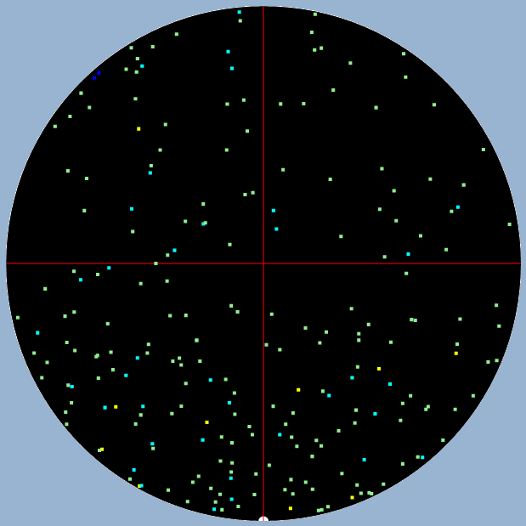
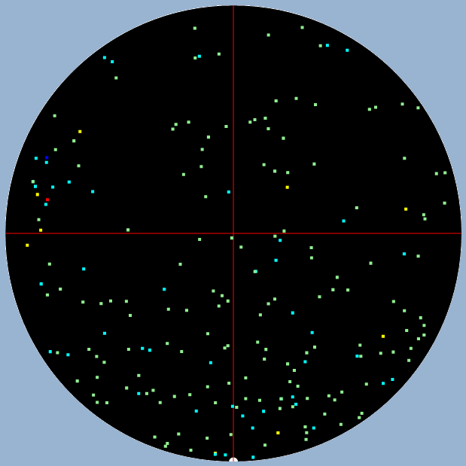
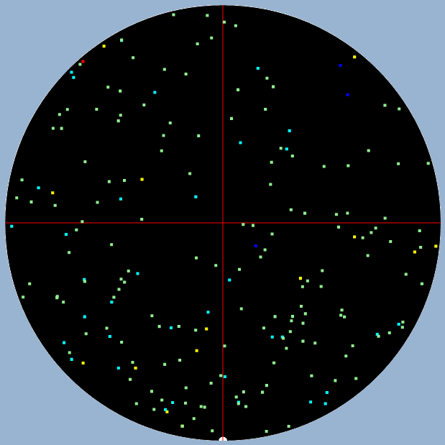
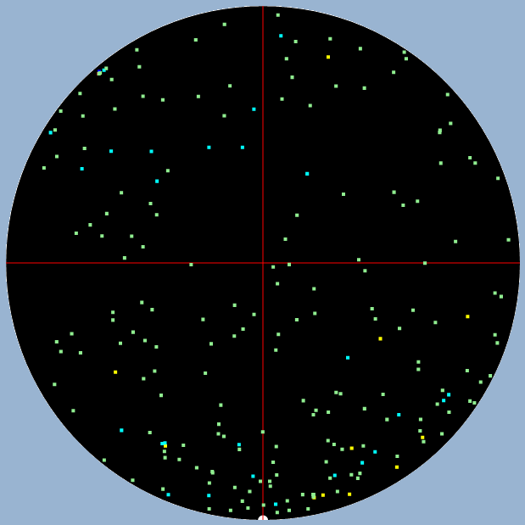
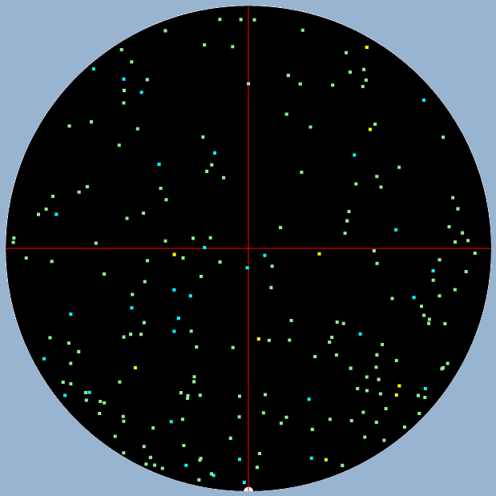
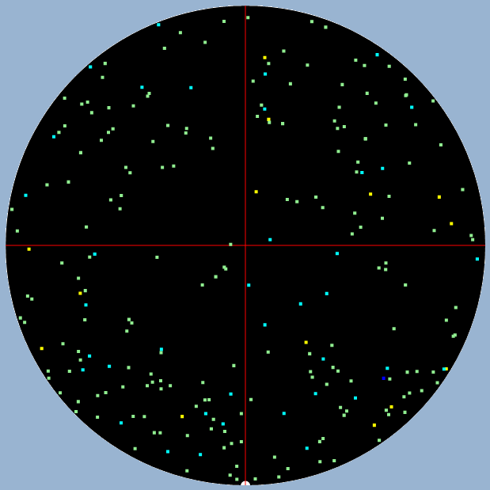
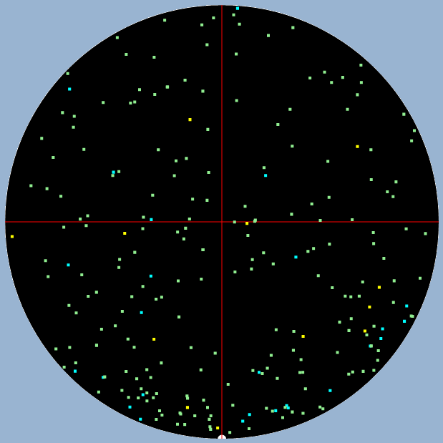
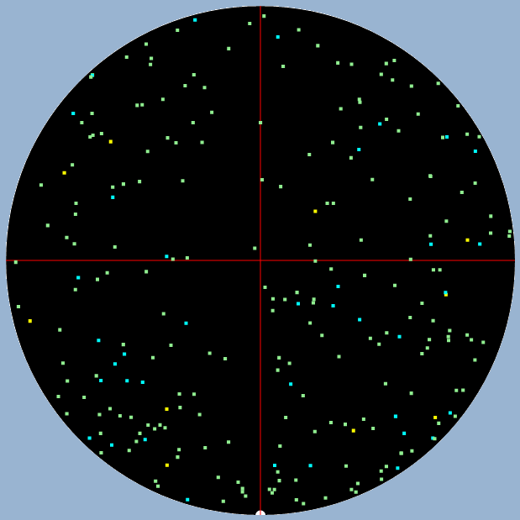
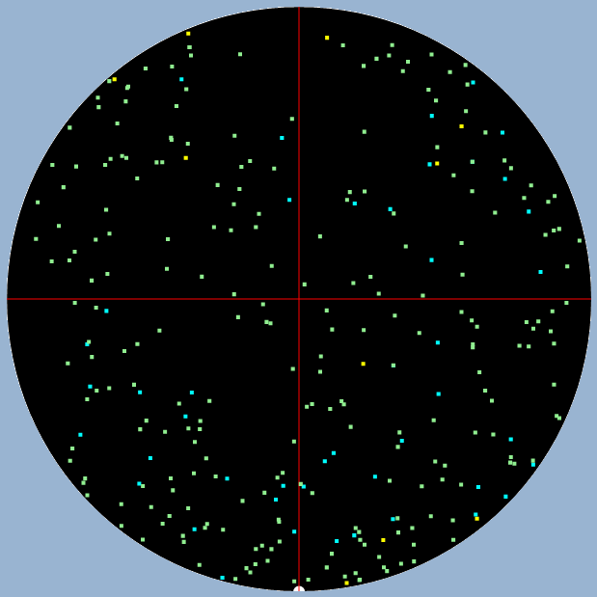
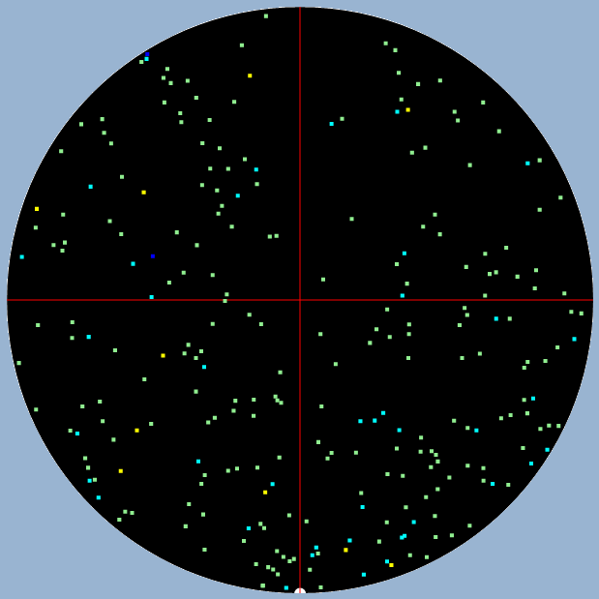
No.15 | No.14 | No.13 | No.12 | No.11
NKAAEE06CCB6 | NKAAEE06D2A0 | NKAAEE06CEA4 | NKAAEDBB16E1 | NKAAEE06CFH2
數量:228 | 數量:210 | 數量:206 | 數量:221 | 數量:
No.10 | No.9 | No.8 | No.7 | No.6
NKAAEE093BG5 | NKAAEE06BEF4 | NKAAEE06C8B2 | NKAAEE06C9A5 | NKAAEDBB17D4
數量:242 | 數量:247 | 數量:252 | 數量:298 | 數量:260

Slide 3
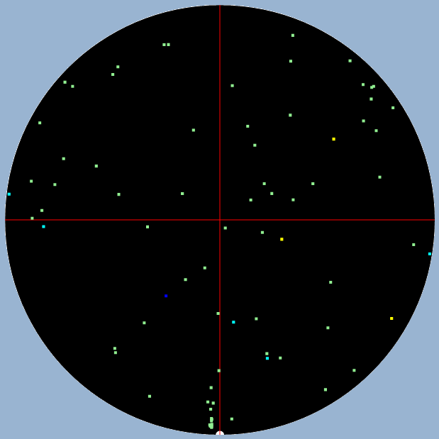
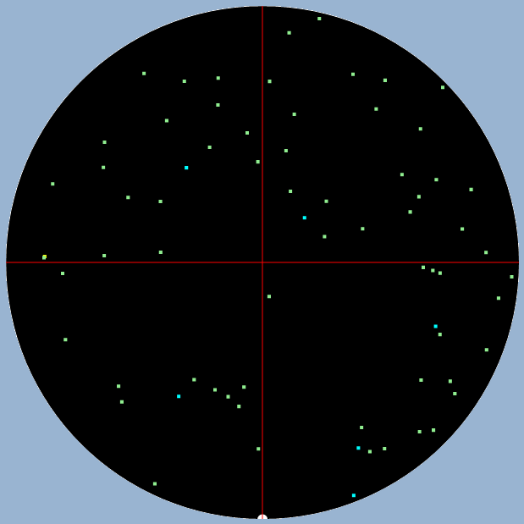
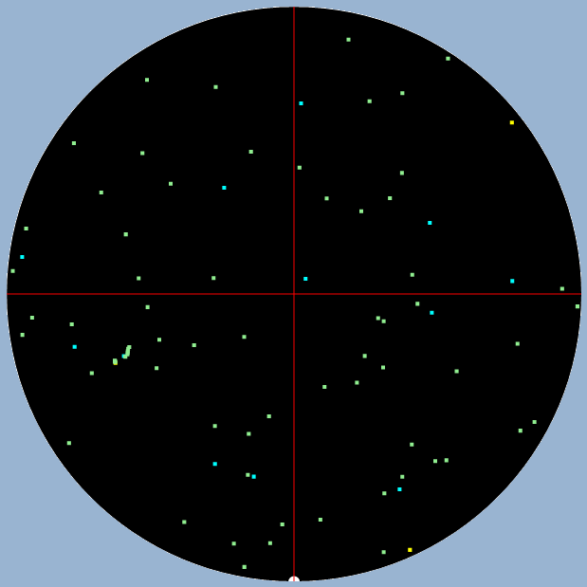
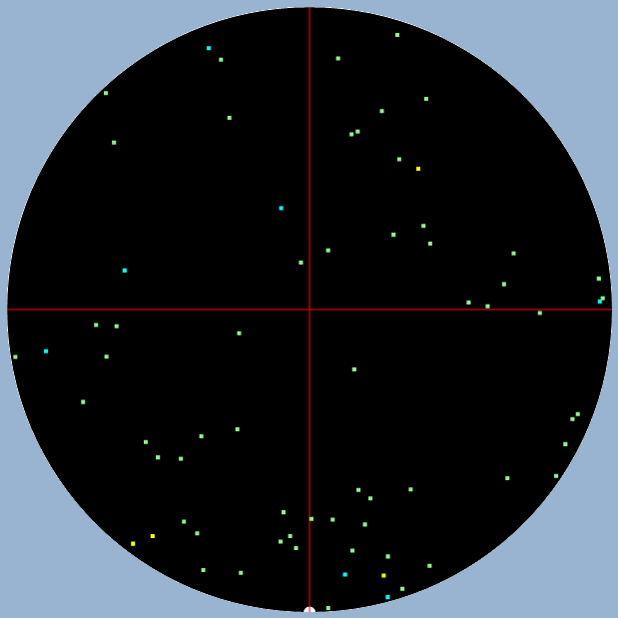
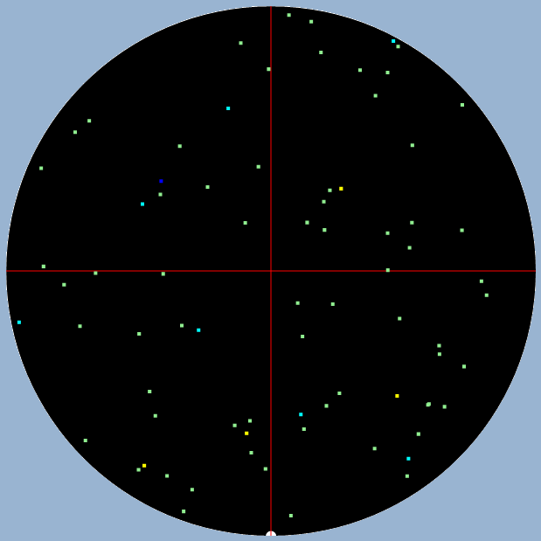
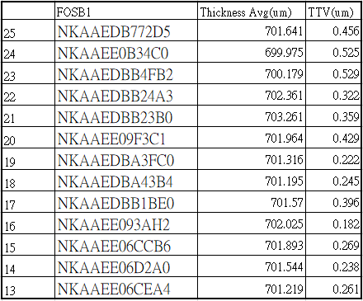
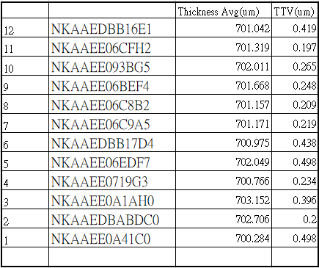
No.5 | No.4 | No.3 | No.2 | No.1
NKAAEE06EDF7 | NKAAEE0719G3 | NKAAEE0A1AH0 | NKAAEDBABDC0 | NKAAEE0A41C0
數量:79 | 數量:71 | 數量:86 | 數量:70 | 數量:77

Slide 4
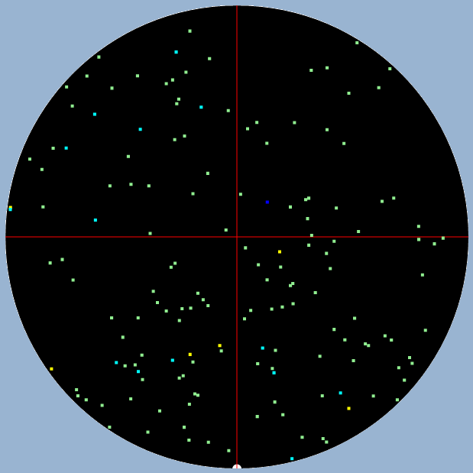
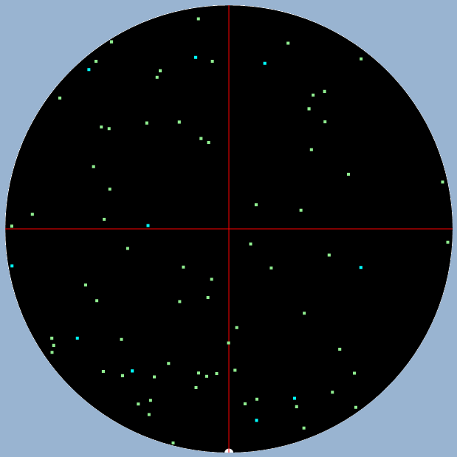
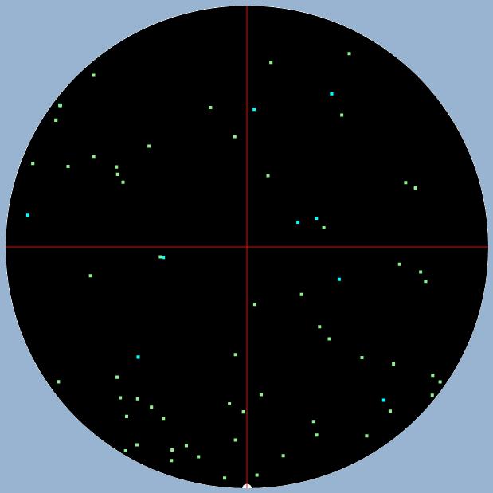
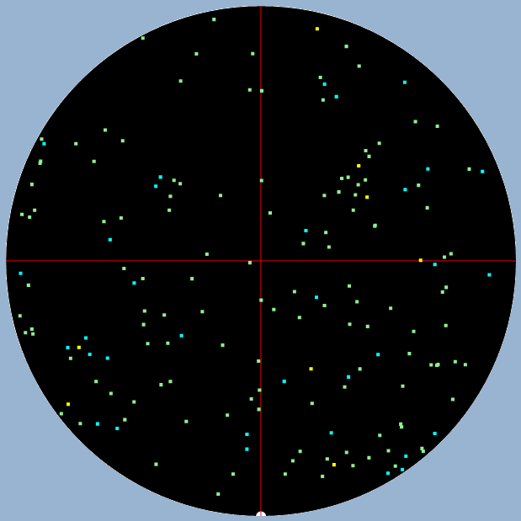
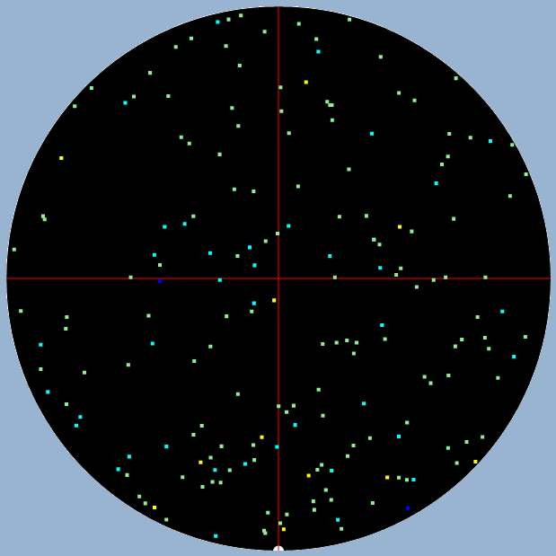
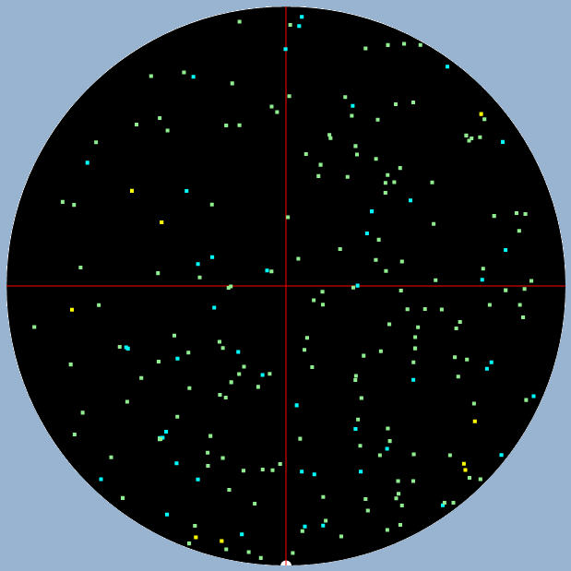
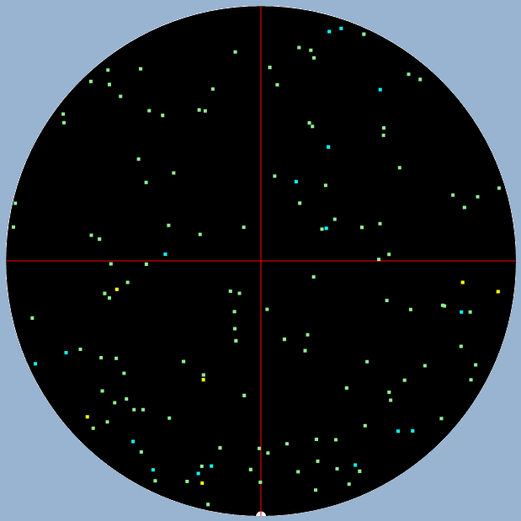
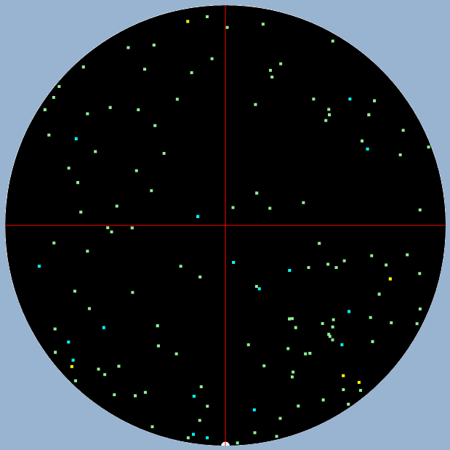
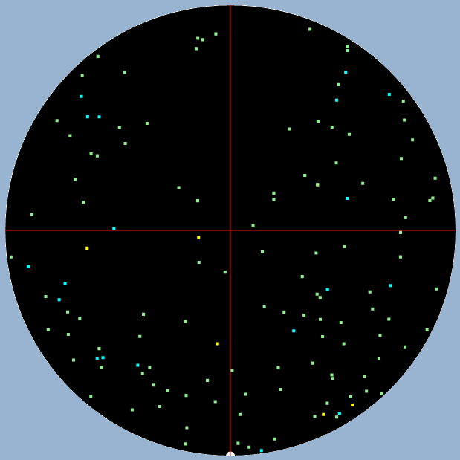
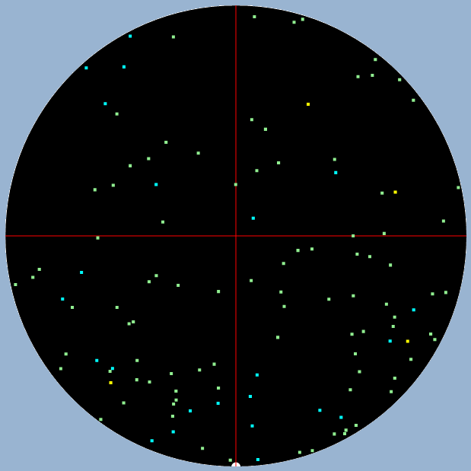
No.25 | No.24 | No.23 | No.22 | No.21
NKAAEDBABAD7 | NKAAEE0A3FB2 | NKAAEDBB30F2 | NKAAEE0B35B3 | NKAAEE0B38G7
數量:158 | 數量:78 | 數量:70 | 數量:172 | 數量:188
No.20 | No.19 | No.18 | No.17 | No.16
NKAAEDBE34A6 | NKAAEE067EB4 | NKAAEE0680C2 | NKAAE238C2G6 | NKAAE238DBG4
數量:225 | 數量:138 | 數量:136 | 數量:135 | 數量:118

Slide 5
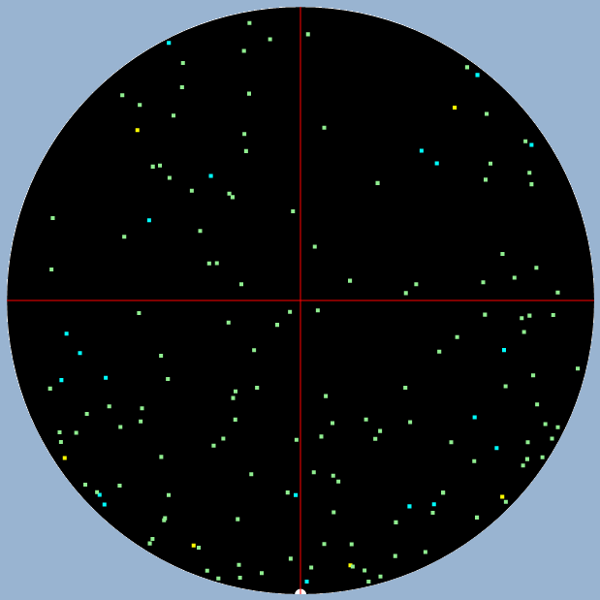
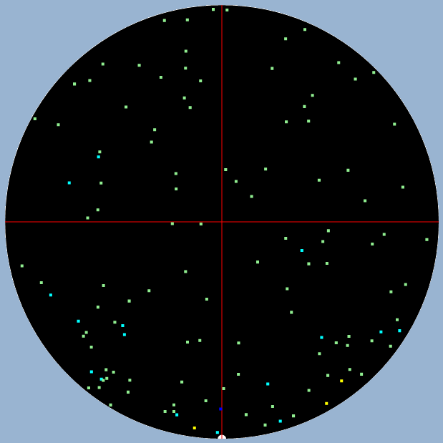
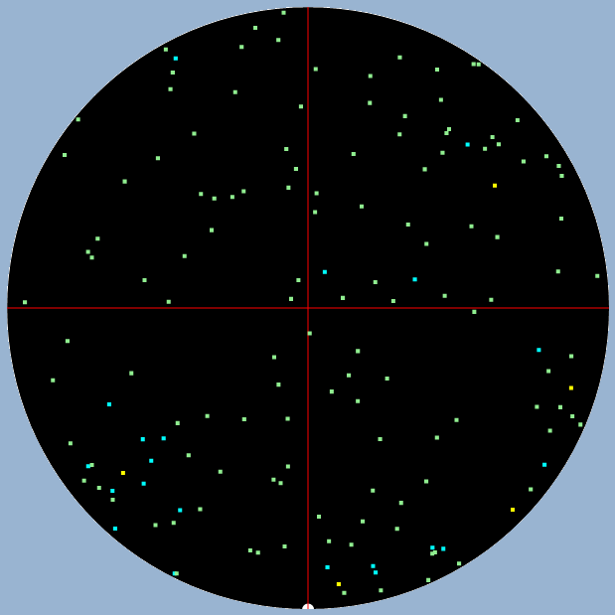
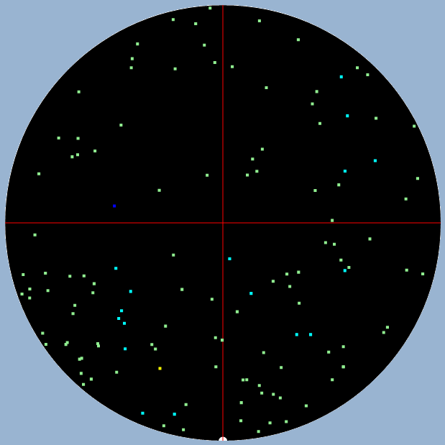
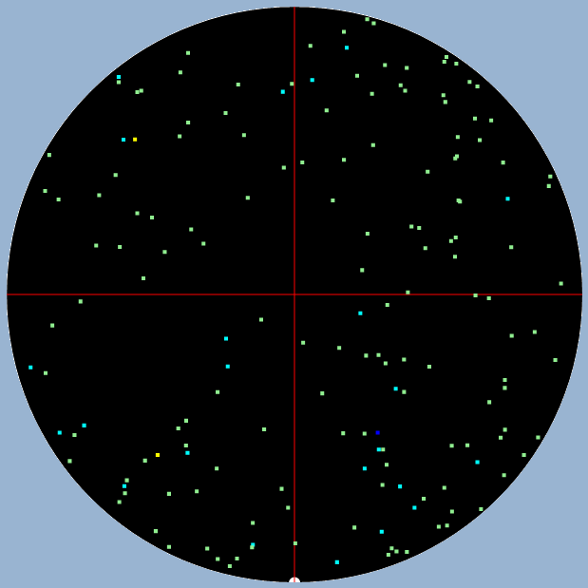
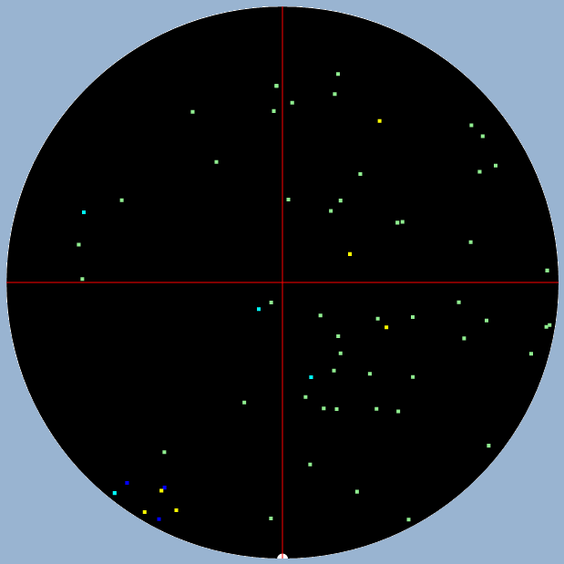
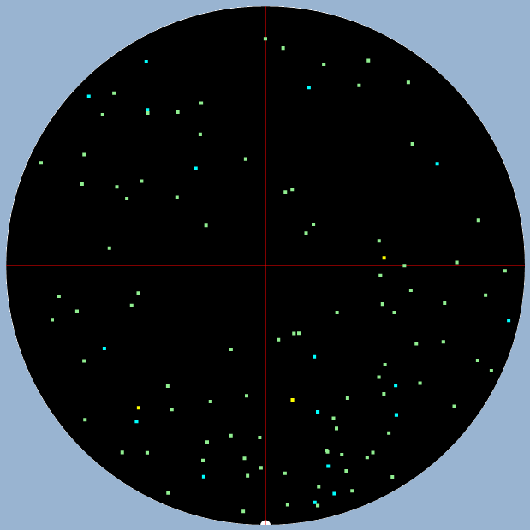
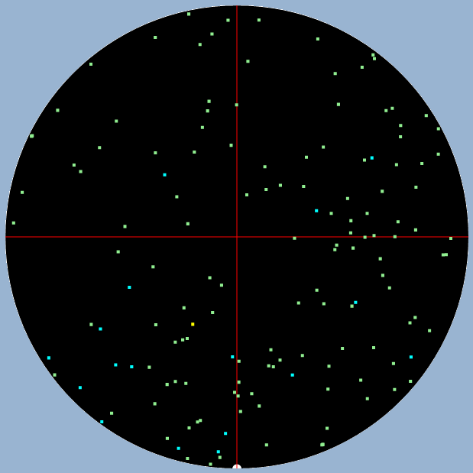
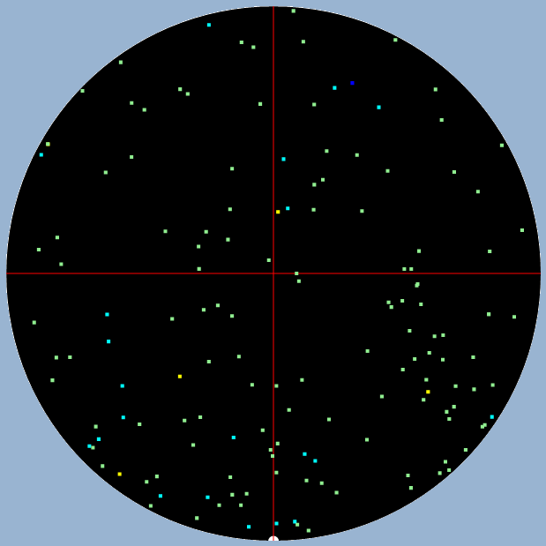
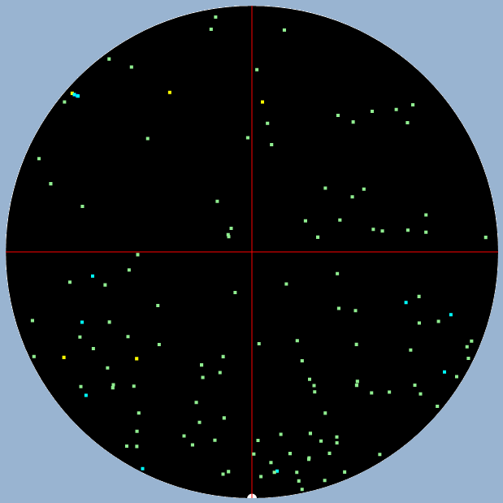
No.15 | No.14 | No.13 | No.12 | No.11
NKAAEE070ED7 | NKAAEE06B4B3 | NKAAEE070DE4 | NKAAEE06C4D6 | NKAAEE0702B0
數量:160 | 數量:125 | 數量:154 | 數量:129 | 數量:167
No.10 | No.9 | No.8 | No.7 | No.6
NKAAEE0B9FF0 | NKAAEE0B9EF5 | NKAAEDB627G4 | NKAAEDB5CCF5 | NKAAEE0B9DG2
數量:63 | 數量:110 | 數量:150 | 數量:150 | 數量:134

Slide 6
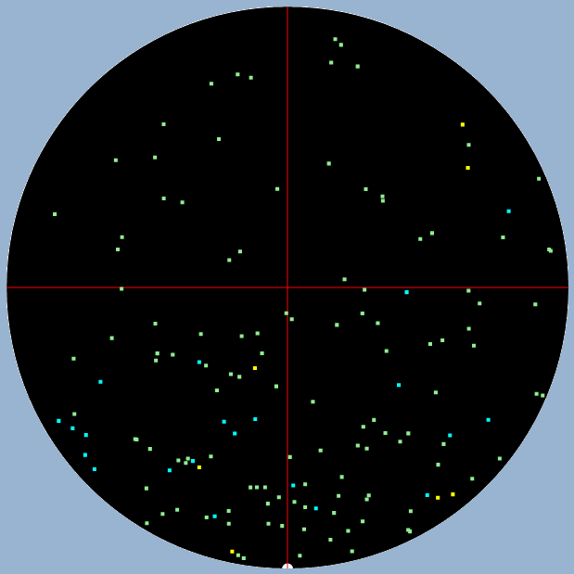
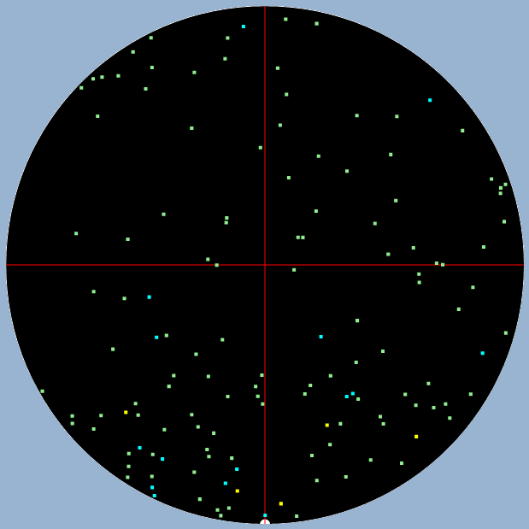
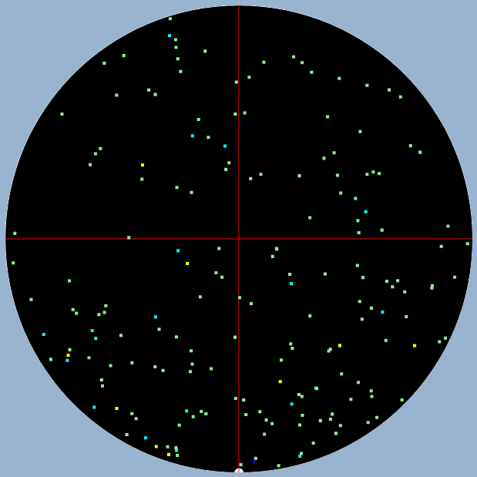




No.5 | No.4 | No.3 | No.2 | No.1
NKAAEE0B9AA6 | NKAAEE0B99F6 | NKAAEE0B9BA1 | NKAAEDBAC1B4 | NKAAEE0A3DC4
數量:147 | 數量:136 | 數量:185 | 數量:183 | 數量:230

Slide 7










No.25 | No.24 | No.23 | No.22 | No.21
NKAAEDB828H0 | NKAAEDBE27D7 | NKAAEE8DB5A3 | NKAAEE8DB4B0 | NKAAEDBABCC5
數量:30 | 數量:237 | 數量:228 | 數量:226 | 數量:235
No.20 | No.19 | No.18 | No.17 | No.16
NKAAE238BEH2 | NKAAEE067AE0 | NKAAEE0670H2 | NKAAEE0685G4 | NKAAEE0687F2
數量:68 | 數量:71 | 數量:67 | 數量:67 | 數量:101

Slide 8










No.15 | No.14 | No.13 | No.12 | No.11
NKAAEE0682B0 | NKAAEE08ADE7 | NKAAEE065BG0 | NKAAEE065CF3 | NKAAE34F49A3
數量:97 | 數量:124 | 數量:148 | 數量:141 | 數量:105
No.10 | No.9 | No.8 | No.7 | No.6
NKAAEE4107F1 | NKAAEDBE2AF0 | NKAAEDBAB9B4 | NKAAEF8B6EE1 | NKAAEE0671G5
數量:204 | 數量:146 | 數量:62 | 數量:64 | 數量:248

Slide 9







No.5 | No.4 | No.3 | No.2 | No.1
NKAAE238C0A5 | NKAAE238C5E7 | NKAAEF89BBD5 | NKAAEE067DC1 | NKAAE238E2E1
數量:259 | 數量:46 | 數量:118 | 數量:124 | 數量:146

Slide 10










No.25 | No.24 | No.23 | No.22 | No.21
NKAAEE8A4ED3 | NKAAEE065EE1 | NKAAEE06EEF2 | NKAAEDBEA6D2 | NKAAEE331CE0
數量:40 | 數量:40 | 數量:178 | 數量:87 | 數量:65
No.20 | No.19 | No.18 | No.17 | No.16
NKAAEE66B6F0 | NKAAEE8DDCD6 | NKAAEE8DB8F7 | NKAAEE0673F3 | NKAAE24FEDF2
數量:145 | 數量:86 | 數量:112 | 數量:60 | 數量:45

Slide 11










No.15 | No.14 | No.13 | No.12 | No.11
NKAAEE8DACE0 | NKAAE24EEBC2 | NKAAE24EEAC7 | NKAAE238DFE0 | NKAAEEAF2AD7
數量:113 | 數量:88 | 數量:119 | 數量:143 | 數量:174
No.10 | No.9 | No.8 | No.7 | No.6
NKAAEEADCDE3 | NKAAEEB21EH0 | NKAAEE8DD8D2 | NKAAEE66CEF3 | NKAAEEB02DB4
數量:234 | 數量:88 | 數量:44 | 數量:131 | 數量:104

Slide 12







No.5 | No.4 | No.3 | No.2 | No.1
NKAAEEB21DA2 | NKAAEEF135G0 | NKAAE238DDF2 | NKAAE238E1E6 | NKAAEDBDDBG0
數量:110 | 數量:167 | 數量:105 | 數量:118 | 數量:156

Slide 13










No.25 | No.24 | No.23 | No.22 | No.21
NKAAEDBB89E1 | NKAAEE06D4G1 | NKAAE2582FH1 | NKAAEE067CC6 | NKAAEE0683A3
數量:37 | 數量:212 | 數量:210 | 數量:170 | 數量:167
No.20 | No.19 | No.18 | No.17 | No.16
NKAAEE0697A2 | NKAAEE0679B5 | NKAAEE0699G3 | NKAAE25834G0 | NKAAEE8DAEC6
數量:172 | 數量:204 | 數量:209 | 數量:250 | 數量:88

Slide 14










No.15 | No.14 | No.13 | No.12 | No.11
NKAAEE4FBCE2 | NKAAEE3322C2 | NKAAEE3315F3 | NKAAEDBEA4E4 | NKAAEEB11DD3
數量:161 | 數量:208 | 數量:210 | 數量:266 | 數量:130
No.10 | No.9 | No.8 | No.7 | No.6
NKAAEEB029B0 | NKAAEEB21AC1 | NKAAEDB649C5 | NKAAEEF11DG5 | NKAAEEF21DD4
數量:163 | 數量:160 | 數量:128 | 數量:226 | 數量:180

Slide 15







No.5 | No.4 | No.3 | No.2 | No.1
NKAAEEF11EG0 | NKAAEEF121G1 | NKAAEE3321C7 | NKAAEEEC33F4 | NKAAE34F4CB4
數量:206 | 數量:233 | 數量:41 | 數量:264 | 數量:117

Slide 16










No.25 | No.24 | No.23 | No.22 | No.21
NKAAEDB97CB4 | NKAAEF407BC3 | NKAAE34F08G2 | NKAAEFBEA6B4 | NKAAEFBB8DC7
數量:58 | 數量:79 | 數量:140 | 數量:71 | 數量:107
No.20 | No.19 | No.18 | No.17 | No.16
NKAAEF407CB6 | NKAAEFBEA4C6 | NKAAEF8B6AG5 | NKAAEF8B6FD4 | NKAAEF8B67F4
數量:102 | 數量:86 | 數量:96 | 數量:43 | 數量:32

Slide 17










No.15 | No.14 | No.13 | No.12 | No.11
NKAAEF8B6BG0 | NKAAEF8B6CF3 | NKAAEF8B70E7 | NKAAEE0717A2 | NKAAEEAF66F4
數量:51 | 數量:51 | 數量:43 | 數量:66 | 數量:86
No.10 | No.9 | No.8 | No.7 | No.6
NKAAEE08ACF4 | NKAAEDB982H1 | NKAAEDB979A3 | NKAAEE084EC7 | NKAAEE0894D2
數量:74 | 數量:94 | 數量:88 | 數量:115 | 數量:99

Slide 18







No.5 | No.4 | No.3 | No.2 | No.1
NKAAEDB9A3F6 | NKAAEDB981A3 | NKAAEDB97EA2 | NKAAEDB97DA7 | NKAAEDB9A1H0
數量:110 | 數量:89 | 數量:102 | 數量:114 | 數量:100

Slide 19










No.25 | No.24 | No.23 | No.22 | No.21
NKAAEFBB8EC2 | NKAAEDB99FE3 | NKAAEDB9A0A2 | NKAAED9D78H2 | NKAAEEF09AB1
數量:83 | 數量:116 | 數量:142 | 數量:202 | 數量:115
No.20 | No.19 | No.18 | No.17 | No.16
NKAAEFBBCFF5 | NKAAEF40ABE0 | NKAAEE0963B0 | NKAAEFBBCEG2 | NKAAEEAE40A2
數量:138 | 數量:226 | 數量:48 | 數量:62 | 數量:139

Slide 20










No.15 | No.14 | No.13 | No.12 | No.11
NKAAEEAE48C5 | NKAAEEAE49C0 | NKAAEEAF01B6 | NKAAEEAF02B1 | NKAAEDE4FEG0
數量:183 | 數量:207 | 數量:193 | 數量:229 | 數量:177
No.10 | No.9 | No.8 | No.7 | No.6
NKAAEDBD37C0 | NKAAEDBCDCB1 | NKAAEDBA3BE4 | NKAAEDBB28F2 | NKAAEDB689E6
數量:51 | 數量:59 | 數量:72 | 數量:86 | 數量:93

Slide 21







No.5 | No.4 | No.3 | No.2 | No.1
NKAAEDB688F3 | NKAAEDB687G0 | NKAAEDBD35D2 | NKAAEDBCDAC3 | NKAAEDBB88E6
數量:112 | 數量:90 | 數量:98 | 數量:138 | 數量:132

Slide 22










No.25 | No.24 | No.23 | No.22 | No.21
NKAAEDBE37G2 | NKAAEDBD3AD1 | NKAAE34F07G7 | NKAAE2582CB5 | NKAAEDBA58A6
數量:111 | 數量:176 | 數量:165 | 數量:156 | 數量:170
No.20 | No.19 | No.18 | No.17 | No.16
NKAAEE09ACC3 | NKAAEE09B1B2 | NKAAEE09AFA4 | NKAAEE0992B3 | NKAAEDBA51F1
數量:154 | 數量:189 | 數量:149 | 數量:208 | 數量:203

Slide 23










No.15 | No.14 | No.13 | No.12 | No.11
NKAAEDBA86B6 | NKAAEDBA54D2 | NKAAEE0700C2 | NKAAEE06DDD4 | NKAAEE0707F2
數量:205 | 數量:233 | 數量:60 | 數量:46 | 數量:50
No.10 | No.9 | No.8 | No.7 | No.6
NKAAEDB816F7 | NKAAEDB7ECE1 | NKAAEDB822D3 | NKAAEE06A6F1 | NKAAEDB7EDD4
數量:72 | 數量:40 | 數量:36 | 數量:79 | 數量:43

Slide 24







No.5 | No.4 | No.3 | No.2 | No.1
NKAAEDB7EFC2 | NKAAEDB824C1 | NKAAEDB778H2 | NKAAEDB779G5 | NKAAEE06A7E4
數量:63 | 數量:81 | 數量:83 | 數量:80 | 數量:85

